Slide 1
DISTRIBUTED FILE SYSTEMS

Slide 2
Introduction
The sharing of stored information is perhaps the most important aspect of distributed resource sharing.
Web servers provide a restricted form of data sharing in which files stored locally,
in file systems at the server or in servers on a local network, are made available to clients throughout the Internet.
The design of large-scale wide area read-write file storage systems poses problems of load balancing, reliability, availability and security,
The requirements for sharing within local networks and intranets lead to a need for a different type of service
One that supports the persistent storage of data and programs of all types on behalf of clients and the consistent distribution of up-to-date data.

Slide 3
Introduction
File systems were originally developed for centralized computer systems and desktop computers as an operating system facility providing a convenient programming interface to disk storage.
Access-control and file-locking mechanisms that made them useful for the sharing of data and programs.
Distributed file systems support the sharing of information in the form of files and hardware resources in the form of persistent storage throughout an intranet.
A well designed file service provides access to files stored at a server with performance and reliability similar to, and in some cases better than, files stored on local disks.

Slide 4
Introduction
A file service enables programs to store and access remote files exactly as they do local ones
allowing users to access their files from any computer in an intranet.
The concentration of persistent storage at a few servers reduces the need for local disk storage
Other services, such as the name service, the user authentication service and the print service, can be more easily implemented when they can call upon the file service to meet their needs for persistent storage.
web servers often store and access the material from a local distributed file system.

Slide 5
Introduction
With the advent of distributed object-oriented programming, a need arose for the persistent storage and distribution of shared objects.
One way to achieve this is to serialize objects and to store and retrieve the serialized objects using files.
But this method for achieving persistence and distribution is impractical for rapidly changing objects,
Java remote object invocation and CORBA ORBs provide access to remote, shared objects
but neither of these ensures the persistence of the objects, nor are the distributed objects replicated.

Slide 6
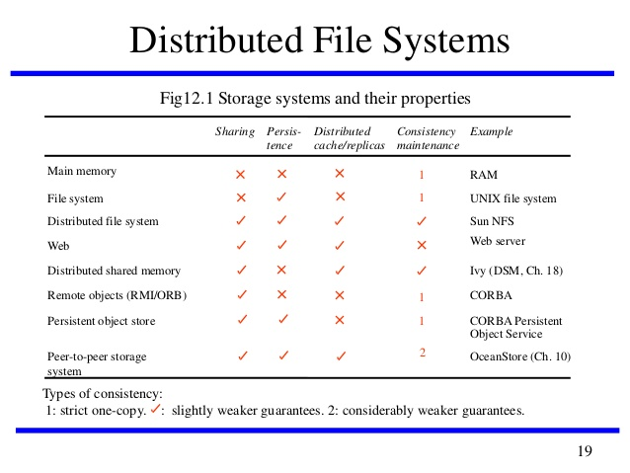

Slide 7
The consistency column indicates whether mechanisms exist for the maintenance of consistency between multiple copies of data when updates occur
Strict consistency is the strongest consistency model. Under this model, a write to a variable by any processor needs to be seen instantaneously by all processors.
Virtually all storage systems rely on the use of caching to optimize the performance of programs.

Slide 8
Caching was first applied to main memory and non-distributed file systems, and for those the consistency is strict
Programs cannot observe any discrepancies between cached copies and stored data after an update.
When distributed replicas are used, strict consistency is more difficult to achieve.
Distributed file systems such as Sun NFS and the Andrew File System cache copies of portions of files at client computers,
adopts specific consistency mechanisms to maintain an approximation to strict consistency

Slide 9
Introduction
The Web uses caching extensively both at client computers and at proxy servers maintained by user organizations.
In computer networks, a proxy server is a server (a computer system or an application) that acts as an intermediary for requests from clients seeking resources from other server
The consistency between the copies stored at web proxies and client caches and the original server is only maintained by explicit user actions.
Clients are not notified when a page stored at the original server is updated;
they must perform explicit checks to keep their local copies up-to-date.

Slide 10
Characteristics of file systems
File systems are responsible for the organization, storage, retrieval, naming, sharing and protection of files.
They provide a programming interface that characterizes the file abstraction, freeing programmers from concern with the details of storage allocation and layout.
Files are stored on disks or other non-volatile storage media.
Files contain both data and attributes.
The data consist of a sequence of data items (typically 8-bit bytes), accessible by operations to read and write any portion of the sequence.
The attributes are held as a single record containing information such as the length of the file, timestamps, file type, owner’s identity and access control lists.

Slide 11
File attribute record structure

Slide 12
File systems are designed to store and manage large numbers of files, with facilities for creating, naming and deleting files.
The naming of files is supported by the use of directories.
A directory is a file, often of a special type, that provides a mapping from text names to internal file identifiers.
File systems also take responsibility for the
control of access to files
restricting access to files according to users’ authorizations
type of access requested (reading, updating, executing and so on).
The term metadata is often used to refer to all of the extra information stored by a file system that is needed for the management of files.
file attributes, directories and all the other persistent information used by the file system.

Slide 13
File system modules

Slide 14
Figure shows a typical layered module structure for the implementation of a non-distributed file system in a conventional operating system.
Each layer depends only on the layers below it.
The implementation of a distributed file service requires all of the components shown there, with additional components to deal with
client-server communication
distributed naming
location of files.

Slide 15
File system operations

Slide 16
File system operations
These system calls are implemented by the kernel;
Application programmers usually access them through procedure libraries such as the C Standard Input/Output Library or the Java file classes
The UNIX operations are based on a programming model in which some file state information is stored by the file system for each running program.
list of currently open files
read-write pointer for each giving the position within the file at which the next read or write operation will be applied.
The file system is responsible for applying access control for files
Checking the rights allowed for the user’s identity in the access control list against the mode of access requested in the open system call

Slide 17
Distributed file system requirements
Many of the requirements and potential pitfalls in the design of distributed services were first observed in the early development of distributed file systems.
Initially, they offered access transparency and location transparency;
During the Subsequent phases of development
Performance
Scalability
concurrency control
fault tolerance
security requirements

Slide 18
Transparency
The file service is usually the most heavily loaded service in an intranet, so its functionality and performance are critical.
The design of the file service should support many of the transparency requirements for distributed systems
The design must balance the flexibility and scalability that derive from transparency against software complexity and performance.

Slide 19
Transparency
Access transparency:
Client programs should be unaware of the distribution of files.
A single set of operations is provided for access to local and remote files.
Programs written to operate on local files are able to access remote files without modification
Location transparency:
Client programs should see a uniform file name space.
Files or groups of files may be relocated without changing their pathnames
User programs see the same name space wherever they are executed.

Slide 20
Transparency
Mobility transparency:
Neither client programs nor system administration tables in client nodes need to be changed when files are moved.
This allows file mobility –files or, more commonly, sets or volumes of files may be moved, either by system administrators or automatically.
Performance transparency:
Client programs should continue to perform satisfactorily while the load on the service varies within a specified range.
Scaling transparency:
The service can be expanded by incremental growth to deal with a wide range of loads and network sizes.

Slide 21
Concurrent file updates
Changes to a file by one client should not interfere with the operation of other clients simultaneously accessing or changing the same file.
The need for concurrency control for access to shared data in many applications is widely accepted and techniques are known for its implementation, but they are costly
Most of the File services follow modern UNIX standards in providing advisory or mandatory file- or record-level locking

Slide 22
File replication
File may be represented by several copies of its contents at different locations.
This has two benefits –
it enables multiple servers to share the load of providing a service to clients accessing the same set of files, enhancing the scalability of the service
it enhances fault tolerance by enabling clients to locate another server that holds a copy of the file when one has failed.
Few file services support replication fully, but most support the caching of files or portions of files locally, a limited form of replication.

Slide 23
Hardware and operating system heterogeneity
The service interfaces should be defined so that client and server software can be implemented for different operating systems and computers.
This requirement is an important aspect of openness.

Slide 24
Fault tolerance
The central role of the file service in distributed systems makes it essential that the service continue to operate in the face of client and server failures.
To cope with transient communication failures, the design can be based on
at-most-once invocation semantics
at-least-once semantics with a server protocol designed in terms of idempotent operations, ensuring that duplicated requests do not result in invalid updates to files.
The servers can be stateless, so that they can be restarted and the service restored after a failure without any need to recover previous state.
Tolerance of disconnection or server failures requires file replication, which is more difficult to achieve

Slide 25
Consistency
Conventional file systems such as that provided in UNIX offer one-copy update semantics.
This refers to a model for concurrent access to files in which the file contents seen by all of the processes accessing or updating a given file are those that they would see if only a single copy of the file contents existed.
When files are replicated or cached at different sites, there is an inevitable delay in the propagation of modifications made at one site to all of the other sites that hold copies
This may result in some deviation from one-copy semantics.

Slide 26
Security
Virtually all file systems provide access-control mechanisms based on the use of access control lists.
In distributed file systems, there is a need to authenticate client requests so that access control at the server is based on correct user identities and to protect the contents of request and reply messages with digital signatures and (optionally) encryption of secret data

Slide 27
Efficiency
A distributed file service should offer facilities that are of at least the same power and generality as those found in conventional file systems and should achieve a comparable level of performance.

Slide 28
File Service Design Options
Stateful
server holds information on open files, current position, file locks
open before access, close after
better performance
shorter message, read-ahead possible
server failure
lose state
client failure
tables fill up
can provide file locks

Slide 29
File Service Design Options
Stateless
no state information held by server
file operations idempotent, must contain all information
needed (longer message)
simpler file server design
can recover easily from client or server crash
locking requires extra lock server to hold state

Slide 30
File service architecture
An architecture that offers a to files is obtained by structuring the file service as three components –
flat file service,
directory service
client module.
The flat file service and the directory service each export an interface for use by client programs, and their RPC interfaces
comprehensive set of operations for access to files.
The client module provides a single programming interface with operations on files similar to those found in conventional file systems.
The design is open in the sense that different client modules can be used to implement different programming interfaces,

Slide 32
Flat file service
The flat file service is concerned with implementing operations on the contents of files.
Unique file identifiers (UFIDs) are used to refer to files in all requests for flat file service operations.
UFIDs are long sequences of bits chosen so that each file has a UFID that is unique among all of the files in a distributed system.
Translates UFIDs to file locations
When the flat file service receives a request to create a file, it generates a new UFID for it and returns the UFID to the requester

Slide 33
Directory service
The directory service provides a mapping between text names for files and their UFIDs.
Clients may obtain the UFID of a file by quoting its text name to the directory service.
The directory service provides the functions needed to generate directories
to add new file names to directories
to obtain UFIDs from directories.
It is a client of the flat file service
its directory files are stored in files of the flat file service.
When a hierarchic file-naming scheme is adopted, as in UNIX, directories hold references to other directories

Slide 34
Client module
A client module runs in each client computer, integrating and extending the operations of the flat file service and the directory service under a single application programming interface
API for file access, one per client computer
The client module also holds information about the network locations of the flat file server and directory server processes.
Client module can play an important role in achieving satisfactory performance through the implementation of a cache of recently used file blocks at the client.
Holds state: open files, positions

Slide 35
Flat file service interface

Slide 36
Comparison with UNIX:
Flat file service has no open and close operations – files can be accessed immediately by quoting the appropriate UFID.
The Read and Write requests in our interface include a parameter specifying a starting point within the file for each transfer, whereas the equivalent UNIX operations do not.
In UNIX, each read or write operation starts at the current position of the read-write pointer, and the read-write pointer is advanced by the number of bytes transferred after each read or write.
A seek operation is provided to enable the read-write pointer to be explicitly repositioned.

Slide 37
The interface to our flat file service differs from the UNIX file system interface mainly for reasons of fault tolerance
Repeatable operations:
With the exception of Create, allowing the use of at-least-once RPC semantics
clients may repeat calls to which they receive no reply.
Repeated execution of Create produces a different new file for each call.
Stateless servers:
The interface is suitable for implementation by stateless servers.
Stateless servers can be restarted after a failure and resume operation without any need for clients or the server to restore any state

Slide 38
Access control
In the UNIX file system, the user’s access rights are checked against the access mode (read or write) requested in the open call
File is opened only if the user has the necessary rights.
The user identity (UID) used in the access rights check is retrieved during the user’s earlier authenticated login and cannot be tampered with in non-distributed implementations.
The resulting access rights are retained until the file is closed

Slide 39
In distributed implementations, access rights checks have to be performed at the server because the server RPC interface is an otherwise unprotected point of access to files.
A user identity has to be passed with requests, and the server is vulnerable to forged identities.
If the results of an access rights check were retained at the server and used for future accesses, the server would no longer be stateless
Two alternative approaches to the problem can be adopted:
An access check is made whenever a file name is converted to a UFID, and the results are encoded in the form of a capability, which is returned to the client for submission with subsequent requests.
A user identity is submitted with every client request, and access checks are performed by the server for every file operation.

Slide 40
Directory service interface

Slide 41
Hierarchic file system
A hierarchic file system such as the one that UNIX provides consists of a number of directories arranged in a tree structure.
Each directory holds the names of the files and other directories that are accessible from it.
Any file or directory can be referenced using a pathname – a multi-part name that represents a path through the tree.
The root has a distinguished name, and each file or directory has a name in a directory.
The UNIX file-naming scheme is not a strict hierarchy – files can have several names, and they can be in the same or different directories.
This is implemented by a link operation, which adds a new name for a file to a specified directory

Slide 42
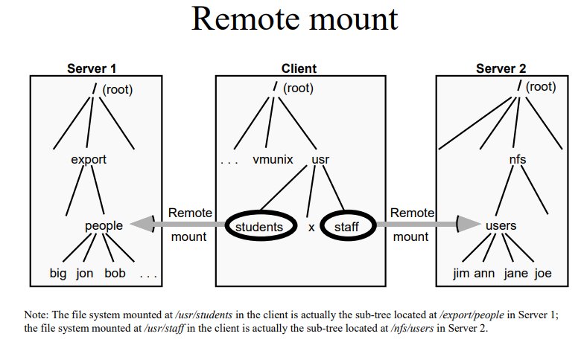

Slide 43
A tree-structured network of directories is constructed with files at the leaves and directories at the other nodes of the tree.
The root of the tree is a directory with a ‘well-known’ UFID.
Multiple names for files can be supported using the AddName operation and the reference count field in the attribute record.
A function can be provided in the client module that gets the UFID of a file given its pathname.
The function interprets the pathname starting from the root, using Lookup to obtain the UFID of each directory in the path.

Slide 44
File groups
A file group is a collection of files located on a given server.
A server may hold several file groups, and groups can be moved between servers, but a file cannot change the group to which it belongs.
In a distributed file service,
file groups support the allocation of files to file servers in larger logical units and enable the service to be implemented with files stored on several servers.
UFIDs includes a file group identifier component, enabling the client module in each client computer to take responsibility for dispatching requests to the server that holds the relevant file group.

Slide 45
File group identifiers must be unique throughout a distributed system.
Way to ensure that file group identifiers will always be distinct in a given system is to generate them with an algorithm that ensures global uniqueness.
For example, whenever a new file group is created, a unique identifier can be generated by concatenating the 32-bit IP address of the host creating the new group with a 16-bit integer derived from the date, producing a unique 48-bit integer:

Slide 46
The Google File System (GFS)
The Google File System (GFS) is a distributed file system;
It is specialized for the very particular requirements that Google has in terms of storage and access to very large quantities of data
These requirements led to very different design decisions from those made in NFS and AFS
The overall goal of GFS is to meet the
Demanding and rapidly growing needs of Google’s search engine
Range of other web applications offered by the Google.

Slide 47
GFS requirements
GFS must run reliably on the physical architecture, that is a very large system built from commodity hardware.
The designers of GFS started with the assumption that components will fail
Hardware components
Software components
Design must be sufficiently tolerant of such failures to enable application-level services to continue their operation in the face of any likely combination of failure conditions.

Slide 48
GFS requirements
GFS is optimized for the patterns of usage within Google, both in terms of the types of files stored and the patterns of access to those files.
The number of files stored in GFS is not huge in comparison with other systems, but the files tend to be massive,.
The patterns of access are also atypical of file systems in general.
Accesses are dominated by sequential reads through large files and sequential writes that append data to files
GFS is very much tailored towards this style of access. Small, random reads and writes do occur and are supported, but the system is not optimized for such cases.
for example, by the storage of many web pages sequentially in single files that are scanned by a variety of data analysis programs.
The level of concurrent access is also high in Google, with large numbers of concurrent appends being particularly prevalent, often accompanied by concurrent reads.

Slide 49
GFS requirements
GFS must meet all the requirements for the Google infrastructure as a whole; that is,
it must scale (particularly in terms of volume of data and number of clients),
it must be reliable in spite of the assumption about failures noted above,
it must perform well and it must be open in that it should support the development of new web applications.
In terms of performance and given the types of data file stored, the system is optimized for high and sustained throughput in reading data, and this is prioritized over latency

Slide 50
GFS interface
GFS provides a conventional file system interface offering a hierarchical namespace with individual files identified by pathnames.
File system does not provide full POSIX compatibility, but many of the operations will be familiar to users of such file systems
create – create a new instance of a file;
delete – delete an instance of a file;
open – open a named file and return a handle;
close – close a given file specified by a handle;
read – read data from a specified file;
write – write data to a specified file.
GFS operations are very similar to those for the flat file service

Slide 51
GFS interface
The API also offers two more specialized operations,
Snapshot
Provides an efficient mechanism to make a copy of a particular file or directory tree structure
Record append.
Multiple clients carry out concurrent appends to a given file.

Slide 52
GFS architecture
The most influential design choice in GFS is the storage of files in fixed-size chunks,
each chunk is 64 megabytes in size.
This is quite large compared to other file system designs.
At one level this simply reflects the size of the files stored in GFS.
At another level, this decision is crucial to providing highly efficient sequential reads and appends of large amounts of data.

Slide 53
GFS architecture
Job of GFS is to provide a mapping from files to chunks and then to support standard operations on files, mapping down to operations on individual chunks.

Slide 54
GFS architecture
Each GFS cluster has a single master and multiple chunkservers (typically on the order of hundreds)
which together provide a file service to large numbers of clients concurrently accessing the data.
The role of the master is to manage metadata about the file system defining the
namespace for files
access control information
mapping of each particular file to the associated set of chunks.
In addition, all chunks are replicated
by default on three independent chunkservers, but the level of replication can be specified by the programmer
The location of the replicas is maintained in the master.

Slide 55
GFS architecture
Replication is important in GFS to provide the necessary reliability in the event of hardware and software failures.
NFS and AFS, do not provide replication with updates
The key metadata is stored persistently in an operation log that supports recovery in the event of crashes (reliability).
In particular, all the information is logged apart from the location of replicas
Recovered by polling chunkservers and asking them what replicas they currently store.

Slide 56
GFS architecture
Although the master is centralized, and hence a single point of failure, the operations log is replicated on several remote machines
so the master can be readily restored on failure.
The benefit of having such a single, centralized master is that it has a global view of the file system and hence it can make optimum management decisions,
for example related to chunk placement.
simpler to implement, allowing Google to develop GFS in a relatively short period of time.

Slide 57
GFS architecture
When clients need to access data starting from a particular byte offset within a file, the GFS client library will first translate this to a file name and chunk index pair.
This is then sent to the master in the form of an RPC request
The master replies with the appropriate chunk identifier and location of the replicas,
This information is cached in the client
Used subsequently to access the data by direct RPC invocation to one of the replicated chunkservers.
This way the master is involved at the start and is then completely out of the loop, implementing a separation of control and data flows

Slide 58
GFS architecture
As the system has grown in usage, problems have emerged with the centralized master scheme:
Despite the separation of control and data flow and the performance optimization of the master, it is emerging as a bottleneck in the design.
Despite the reduced amount of metadata stemming from the large chunk size, the amount of metadata stored by each master is increasing to a level where it is difficult to actually keep all metadata in main memory.
Google is now working on a distributed master solution.

Slide 59
GFS architecture
Caching:
caching often plays a crucial role in the performance and scalability of a file system
GFS does not make heavy use of caching
Information about the locations of chunks is cached at clients when first accessed, to minimize interactions with the master.
GFS clients do not cache file data. Given the fact that most accesses involve sequential streaming,
By limiting caching at clients, GFS also avoids the need for cache coherency protocols
GFS also does not provide any particular strategy for server-side caching (chunkservers)
Relying on the buffer cache in Linux to maintain frequently accessed data in memory.

Slide 60
GFS architecture
Logging:
GFS is a key example of the use of logging in Google to support debugging and performance analysis.
GFS servers all maintain extensive diagnostic logs that store significant server events and all RPC requests and replies.
These logs are monitored continually and used in the event of system problems to identify the underlying causes.

Slide 61
GFS architecture
Managing consistency in GFS
Given that chunks are replicated in GFS, it is important to maintain the consistency of replicas in the face of operations that alter the data
the write and record append operations.
GFS provides an approach for consistency management
Maintains the previously mentioned separation between control and data and hence allows high-performance updates to data with minimal involvement of masters;
Provides a relaxed form of consistency recognizing, for example, the particular semantics offered by record append.

Slide 62
When a mutation (i.e., a write, append or delete operation) is requested for a chunk
Master grants a chunk lease to one of the replicas, which is then designated as the primary.
Primary is responsible for providing a serial order for all the currently pending concurrent mutations to that chunk.
A global ordering is thus provided by the ordering of the chunk leases combined with the order determined by that primary.
lease permits the primary to make mutations on its local copies and to control the order of the mutations at the secondary copies

Slide 63
The steps involved in mutations are therefore as follows
On receiving a request from a client, the master grants a lease to one of the replicas (the primary) and returns the identity of the primary and other (secondary) replicas to the client.
The client sends all data to the replicas, and this is stored temporarily in a buffer cache and not written until further instruction
Once all the replicas have acknowledged receipt of this data, the client sends a write request to the primary;
Primary then determines a serial order for concurrent requests and applies updates in this order at the primary site.

Slide 64
The primary requests that the same mutations in the same order are carried out at secondary replicas
secondary replicas send back an acknowledgement when the mutations have succeeded
If all acknowledgements are received, the primary reports success back to the client;
otherwise, a failure is reported indicating that the mutation succeeded at the primary and at some but not all of the replicas.
GFS attempts to overcome this failure by retrying the failed mutations.
In the worst case, this will not succeed and therefore consistency is not guaranteed by the approach

Slide 65
Managing consistency in GFS
GFS adopts a passive replication architecture
In passive replication, updates are sent to the primary and the primary is then responsible for sending out subsequent updates to the backup servers and ensuring they are coordinated.
In GFS, the client sends data to all the replicas but the request goes to the primary, which is then responsible for scheduling the actual mutations
This allows the transmission of large quantities of data to be optimized independently of the control flow.

Slide 66
Managing consistency in GFS
In mutations, there is an important distinction between write and record append operations.
Writes specify an offset at which mutations should occur, whereas record appends do not
In the write, the location is predetermined
In Record append, the system decides.
Concurrent writes to the same location are not serializable and may result in corrupted regions of the file.
With record append operations, GFS guarantees the append will happen at least once and atomically
the system does not guarantee, though, that all copies of the chunk will be identical

Slide 67
Name Services

Slide 68
Introduction
In a distributed system, names are used to refer to a wide variety of resources such as computers, services, remote objects and files, as well as to users.
Names facilitate communication and resource sharing.
A name is needed to request a computer system to act upon a specific resource chosen out of many;
for example, a name in the form of a URL is needed to access a specific web page.
Processes cannot share particular resources managed by a computer system unless they can name them consistently.
Users cannot communicate with one another via a distributed system unless they can name one another,
for example, with email addresses.

Slide 69
Introduction
Names
Fundamental in distributed systems
Facilitates communication and resource sharing
A consistent naming system is required
Adresses: locations of objects, not identifiers

Slide 70
Introduction
Names are not the only useful means of identification: descriptive attributes are another.
Sometimes clients do not know the name of the particular entity
but they do have some information that describes it.
They may require a service and know some of its characteristics but not what entity implements it.

Slide 71
Introduction
Name service
Translates a human-readable name into a system-internal identifier
Ex human readable names:
http://www.facebook.com URL
www.facebook.com Internet Domain Name
/etc/passwd File name
Ex system-internal name:
123.25.7.34 IP address

Slide 72
Names, addresses and other attributes
Any process that requires access to a specific resource must possess a name or an identifier
Examples of human-readable names are
file names such as /etc/passwd,
URLs such as http://www.cdk5.net/
Internet domain names such as www.cdk5.net.
Identifier is sometimes used to refer to names that are interpreted only by programs.
Remote object references and NFS file handles are examples of identifiers.
Identifiers are chosen for the efficiency with which they can be looked up and stored by software.

Slide 73
pure name and other names
Pure names are simply un interpreted bit patterns.
Non-pure names contain information about the object that they name;
Contain information about the location of the object.
Pure names always have to be looked up before they can be of any use.
Pure name is an object’s address:
Value that identifies the location of the object rather than the object itself.
Addresses are efficient for accessing objects,
but objects can sometimes be relocated, so addresses are inadequate as a means of identification.

Slide 74
Names, addresses and other attributes
We say that a name is resolved
when it is translated into data about the named resource or object,
Binding
The association between a name and an object
Names are bound to attributes of the named objects, rather than the implementation of the objects themselves.
An attribute is the value of a property associated with an object.
A key attribute of an entity that is usually relevant in a distributed system is its address

Slide 75
General terms
Resolution : Translation of a name into data
Binding : Association between an object and a name
Context :Set of bindings
Attributes: value of property of an object
Ex: address
Ex Name Service:
Domain Name System (DNS)
maps domain names to the attributes of a host computer: its IP address,the type of entry
X500 directory service
map a person’s name onto attributes (email address and telephone number)
CORBA Naming Service
maps the name of a remote object onto its remote object reference

Slide 76
An IP address must be looked up to obtain a network address such as an Ethernet address.
Web browsers and email clients make use of the DNS to interpret the domain names in URLs and email addresses

Slide 78
Name Service
A name service stores the collection of one or more naming contexts
Major operation: Look at attributes of a given name
Other operations required
Adding/deleting bindings
Listing bound names
Adding/deleting context
Name management is separated from other services
Unification: use the same naming scheme
Integration: Openness

Slide 79
Names and services
Many of the names used in a distributed system are specific to some particular service.
For example, users of the social networking web site twitter.com, have names such as @magmapoetry that no other service resolves.
Client may use a service-specific name when requesting a service to perform an operation upon a named object or resource that it manages.
For example, a file name and a process identifier
Names are also sometimes needed to refer to entities in a distributed system that are beyond the scope of any single service.
users (with proper names and email addresses)
computers (with hostnames such as www.cdk5.net)
Services (File Services)

Slide 80
Names and services
Note that many of these names must be readable by and meaningful to humans,
since users and system administrators need to refer to the major components and configuration of distributed systems
programmers need to refer to services in programs
users need to communicate with each other via the distributed system and discuss what services are available in different parts of it.

Slide 81
Uniform Resource Identifiers
Uniform Resource Identifiers (URIs)
To identify resources on the Web, and other Internet resources such as electronic mailboxes.
Goal was to identify resources in a coherent way
so that they could all be processed by common software such as browsers.
URIs are ‘uniform’
Syntax incorporates that of indefinitely many individual types of resource identifiers
Procedures for managing the global namespace of schemes.
The advantage of uniformity
It eases the process of introducing new types of identifier,
Using existing types of identifier in new contexts, without disrupting existing usage.

Slide 82
Uniform Resource Locators
Some URIs contain information that can be used to locate and access a resource;
others are pure resource names.
The familiar term Uniform Resource Locator (URL) is often used for URIs
Provide location information
Specify the method for accessing the resource, including the ‘http’
For example,
http://www.cdk5.net/ identifies a web page at the given path (‘/’) on the host www.cdk5.net, and specifies that the HTTP protocol be used to access it.
‘mailto’ URL, such as mailto:fred@flintstone.org, which identifies the mailbox at the given address.

Slide 83
URLs are efficient identifiers for accessing resources.
Suffer from the disadvantage
if a resource is deleted or if it moves, say from one web site to another,
Dangling links to the resource containing the old URL.
If a user clicks on a dangling link to a web resource,
Web server will either respond that the resource is not found
OR supply a different resource that now occupies the same location.

Slide 84
Uniform Resource Names:
Uniform Resource Names (URNs) are URIs that are used as pure resource names rather than locators.
For example,
the URI: mid:0E4FC272-5C02-11D9-B115-000A95B55BC8@hpl.hp.com
URN that identifies the email message containing it in its ‘Message-Id’ field.
The URI distinguishes that message from any other email message.
But it does not provide the message’s address in any store, so a lookup operation is needed to find it.

Slide 85
Uniform Resource Names:
A special subtree of URIs beginning with urn: has been reserved for URNs
urn:nameSpace:nameSpace-specificName.
For example
urn:ISBN:0-201-62433-8 identifies books that bear the name 0-201-62433-8 in the standard ISBN naming scheme.
urn:doi:10.555/music-pop-1234 refers to the publication called music-pop-1234 in the naming scheme of the publisher known as 10.555 in the Digital Object Identifier (DOI) scheme

Slide 86
There are resolution services such as the Handle System for resolving URNs such as DOIs to resource attributes,
none is in widespread use
‘cool URLs do not change’
everyone should assign URLs to resources with guarantees about their continuity of reference.

Slide 87
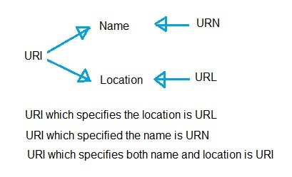

Slide 88
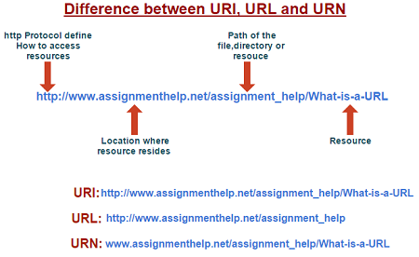

Slide 89
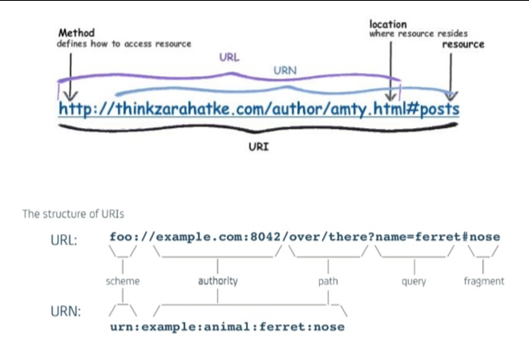

Slide 90
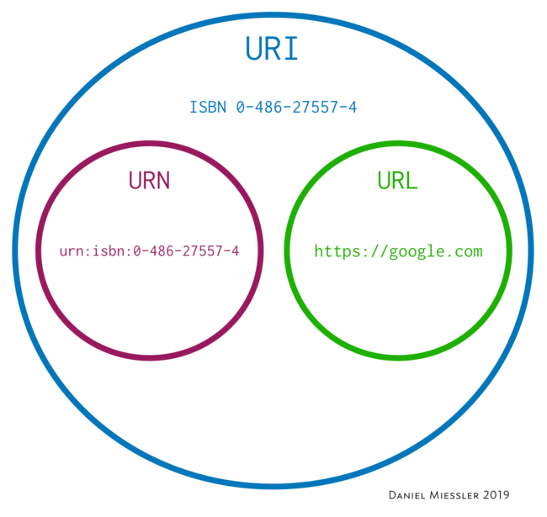

Slide 91
Name services and Domain Name System
Name service stores information about a collection of textual names,
Bindings between the names and the attributes of the entities such as users, computers, services and objects.
The collection is often subdivided into one or more naming contexts:
Major operation that a name service supports is to resolve a name
that is, to look up attributes from a given name.
Operations are also required for
creating new bindings
deleting bindings
listing bound names
adding and deleting contexts.

Slide 92
Motivation- Naming Service
Name management is separated from other services largely because of the openness of distributed systems
Unification:
It is often convenient for resources managed by different services to use the same naming scheme- URIs
Integration:
It may become necessary to share
Name resources that were created in different administrative domains.
Without a common name service, the administrative domains may use entirely different naming conventions.

Slide 93
General name service requirements
Name services were originally quite simple
since they were designed only to meet the need to bind names to addresses in a single management domain, corresponding to a single LAN or WAN.
The interconnection of networks and the increased scale of distributed systems have produced a much larger name-mapping problem.
Grapevine [Birrell et al. 1982] was one of the earliest extensible, multi-domain name services.
It was designed to be scalable in the number of names and the load of requests that it could handle.
Global Name Service, developed at the Digital Equipment Corporation Systems Research Center [Lampson 1986], is a descendant of Grapevine with ambitious goals

Slide 94
Goals of Global Name Service
To handle an essentially arbitrary number of names and to serve an arbitrary number of administrative organizations:
Ex: the system should be capable of handling the names of all the documents in the world.
A long lifetime:
Many changes will occur in the organization of the set of names and in the components that implement the service during its lifetime.
High availability:
Most other systems depend upon the name service; they can’t work when it is broken.
Fault isolation: Local failures should not cause the entire service to fail.
Tolerance of mistrust:
A large open system cannot have any component that is trusted by all of the clients in the system.

Slide 95
Name spaces
A name space is the collection of all valid names recognized by a particular service.
The service will attempt to look up a valid name, even though that name may prove not to correspond to any object – i.e., to be unbound.
Name spaces require a syntactic definition to separate valid names from invalid names.
For example, ‘...’ is not acceptable as the DNS name of a computer
whereas www.cdk99.net is valid

Slide 96
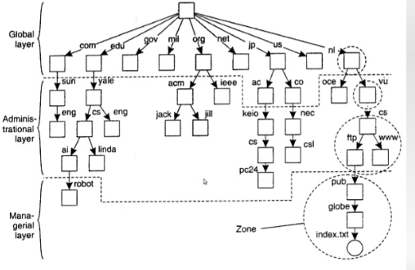

Slide 97
Names may have an internal structure that represents their position in a hierarchic name space such as
pathnames in a file system,
organizational hierarchy such as Internet domain names;
they may be chosen from a flat set of numeric or symbolic identifiers.
One important advantage of a hierarchy is that it makes large name spaces more manageable.
Each part of a hierarchic name is resolved relative to a separate context of relatively small size,
same name may be used with different meanings in different contexts, to suit different situations of use.
In the case of file systems, each directory represents a context.

Slide 98
Hierarchic name spaces are potentially infinite, so they enable a system to grow indefinitely.
flat name spaces are usually finite;
their size is determined by fixing a maximum permissible length for names.
Another potential advantage of a hierarchic name space is that different contexts can be managed by different people or organizations.

Slide 99
DNS names are strings called domain names.
examples are www.cdk5.net (a computer)
net, com and ac.uk (the latter three are domains).
DNS name space has a hierarchic structure:
Domain name consists of one or more strings called name components or labels, separated by the delimiter ‘.’
The name components are non-null printable strings that do not contain ‘.’
In general, a prefix of a name is an initial section of the name that contains only zero or more entire components.
For example, in DNS www and www.cdk5 are both prefixes of www.cdk5.net.
DNS names are not case-sensitive, so www.cdk5.net and WWW.CDK5.NET have the same meaning.

Slide 100
DNS servers do not recognize relative names:
All names are referred to the global root.
In practical implementations, client software keeps a list of domain names that are appended automatically to any single-component name before resolution.
For example, the name www presented in the domain cdk5.net probably refers to www.cdk5.net;
client software will append the default domain cdk5.net and attempt to resolve this name.
If this fails, then further default domain names may be appended;

Slide 101
Aliases
Alias is a name defined to denote the same information as another name,
Aliases allow more convenient names to be substituted for relatively complicated ones,
Allow alternative names to be used by different people for the same entity.
An example is the common use of URL shorteners,
Often used in Twitter posts and other situations where space is at a premium.
For example
http://bit.ly/ctqjvH refers to http://cdk5.net/additional/rmi/programCode/ShapeListClient.java.
DNS allows aliases in which one domain name is defined to stand for another.
Aliases are often used to specify the names of machines that run a web server or an FTP server.
For example, the name www.cdk5.net is an alias for cdk5.net
if the web server is moved to another computer, only the entry for cdk5.net needs to be updated in the DNS database.

Slide 102
Naming domains
A naming domain is a name space for which there exists a single overall administrative authority responsible for assigning names within it.
Authority is in overall control of which names may be bound within the domain, but it is free to delegate this task.
Domains in DNS are collections of domain names;
Domain’s name is the common suffix of the domain names within it, but otherwise it cannot be distinguished
Example, a computer name. For example, net is a domain that contains cdk5.net
The administration of domains may be devolved to subdomains.

Slide 103
dcs.qmul.ac.uk
Department of Computer Science at Queen Mary,
University of London in the UK – can contain any name the department wishes.
But the domain name dcs.qmul.ac.uk itself had to be agreed with the college authorities, who manage the domain qmul.ac.uk.
Similarly, qmul.ac.uk had to be agreed with the registered authority for ac.uk, and so on.
Responsibility for a naming domain normally goes hand in hand
Responsibility for managing and keeping up-to-date the corresponding part of the database stored in an authoritative name server and used by the name service.
Naming data belonging to different naming domains are in general stored by distinct name servers managed by the corresponding authorities.

Slide 104
Combining and customizing name spaces
The DNS provides a global and homogeneous name space in which a given name refers to the same entity,
Some name services allow distinct name spaces – sometimes heterogeneous name spaces – to be embedded into them;
Some name services allow the name space to be customized to suit the needs of individual groups, users or even processes.

Slide 105
Merging
The practice of mounting file systems in UNIX and NFS provides an example in which a part of one name space is conveniently embedded in another.
But consider how to merge the entire UNIX file systems of two (or more) computers called red and blue.
Each computer has its own root, with overlapping file names.
/etc/passwd refers to one file on red and a different file on blue.
The obvious way to merge the file systems is to replace each computer’s root with a ‘super root’ say as /red and /blue.
Users and programs can then refer to /red/etc/passwd and /blue/etc/passwd.
But the new naming convention by itself would cause programs on the two computers that still use the old name /etc/passwd to malfunction.
A solution is to leave the old root contents on each computer and embed the mounted file systems /red and /blue of both computers

Slide 106
We can always merge name spaces by creating a higher-level root context
but this may raise a problem of backward-compatibility.
Fixing the compatibility problem, in turn, leaves us with hybrid name spaces
inconvenience of having to translate old names between the users of the two computers.

Slide 107
Heterogeneity:
The Distributed Computing Environment (DCE) name allows heterogeneous name spaces to be embedded within it.
DCE names may contain junctions,
which are similar to mount points in NFS and UNIX except that they allow heterogeneous name spaces to be mounted.
For example,
Consider the full DCE name /.../dcs.qmul.ac.uk/principals/Jean.Dollimore.
The first part of this name, /.../dcs.qmul.ac.uk, denotes a context called a cell.
The next component is a junction.

Slide 108
For example, the junction principals is a context containing security principals in which
final component, Jean.Dollimore, may be looked up, and in which these principal names have their own syntax.
Similarly, in /.../dcs.qmul.ac.uk/files/pub/reports/TR2000-99,
junction files is a context corresponding to a file system directory,
final component pub/reports/TR2000-99 is looked up and in which the file name space has a distinct syntax.
The two junctions principals and files are the roots of heterogeneous name spaces,
implemented by heterogeneous name services.

Slide 109
Customization:
File system mounting enables users to import files that are stored on servers and shared,
While the other names continue to refer to local, unshared files and can be administered autonomously.
But the same files accessed from two different computers may be mounted at different points and thus have different names.
Not sharing the entire name space means users must translate names between computers.

Slide 110
The Spring naming service [Radia et al. 1993] provides the ability to construct name spaces dynamically and to share individual naming contexts selectively.
Even two different processes on the same computer can have different naming contexts.
Spring naming contexts are first-class objects that can be shared around a distributed system.
For example, suppose a user on computer red wishes to run a program on blue that issues file pathnames such as /etc/passwd,
but these names are to resolve to the files on red’s file system, not blue’s.
This can be achieved in Spring by passing a reference to red’s local naming context to blue and using it as the program’s naming context.

Slide 111
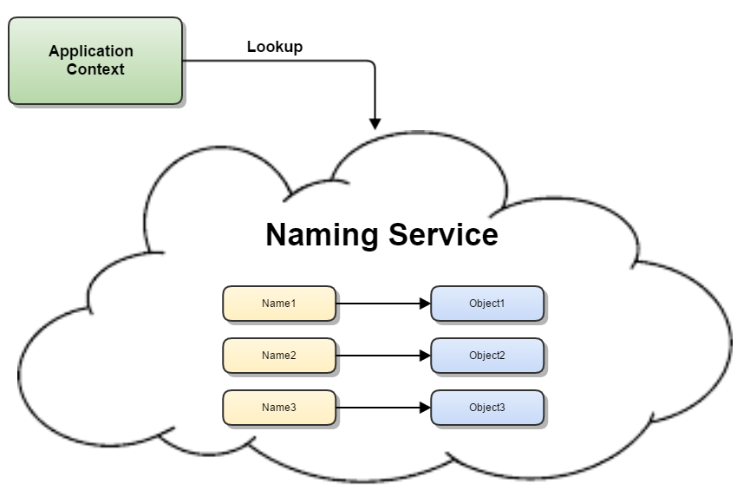

Slide 112
Plan 9 [Pike et al. 1993] also allows processes to have their own file system name space.
A novel feature of Plan 9 is that physical directories can be ordered and merged into a single logical directory.
The effect is that a name looked up in the single logical directory is looked up in the succession of physical directories until there is a match, when the attributes are returned.
This eliminates the need to supply lists of paths when looking for program or library files.

Slide 113
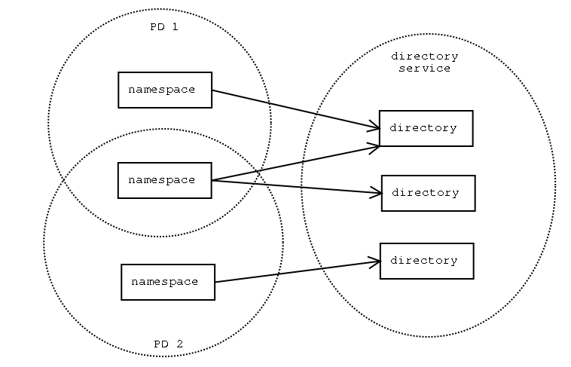

Slide 114
Name resolution
For the common case of hierarchic name spaces, name resolution is an iterative or recursive process.
A naming context either maps a given name onto a set of primitive attributes or maps it onto a further naming context
derived name to be presented to that context.
To resolve a name, it is first presented to some initial naming context;
Resolution iterates as long as further contexts and derived names are output.
Example:
/etc/passwd, in which ‘etc’ is presented to the context ‘/’
then ‘passwd’ is presented to the context ‘/etc’.

Slide 115
Example of the iterative nature of resolution is the use of aliases.
whenever a DNS server is asked to resolve an alias such as www.dcs.qmul.ac.uk
Server first resolves the alias to another domain name (in this case traffic.dcs.qmul.ac.uk),
which must be further resolved to produce an IP address.

Slide 116
Name servers and navigation
Any name service, such as DNS, that stores a very large database and is used by a large population
Such a server would be a bottleneck and a critical point of failure.
Any heavily used name services should use replication to achieve high availability.
DNS specifies that each subset of its database is replicated in at least two failure-independent servers.
Name server may store data for more than one domain

Slide 117
Name servers and navigation
The partitioning of data implies that the local name server cannot answer all enquiries without the help of other name servers.
For example,
Name server in the dcs.qmul.ac.uk domain would not be able to supply the IP address of a computer in the domain cs.purdue.edu unless it was cached

Slide 118
Name servers and navigation
The process of locating naming data from more than one name server in order to resolve a name is called navigation.
The client name resolution software carries out navigation on behalf of the client.
It communicates with name servers as necessary to resolve a name.
It may be provided as library code and linked into clients,
Example : BIND implementation for DNS.

Slide 119
Name servers and navigation
One navigation model that DNS supports is known as iterative navigation
To resolve a name,
client presents the name to the local name server, which attempts to resolve it.
If the local name server has the name, it returns the result immediately.
If it does not, it will suggest another server that will be able to help.
Resolution proceeds at the new server, until the name is located or is discovered to be unbound.
The DNS database is partitioned between servers in such a way as to allow many queries to be satisfied locally and others to be satisfied without needing to resolve each part of the name separately

Slide 121
Name servers and navigation
In multicast navigation, a client multicasts the name to be resolved and the required object type to the group of name servers.
Only the server that holds the named attributes responds to the request.
if the name proves to be unbound, the request is greeted with silence.

Slide 122
Name servers and navigation
Another alternative to the iterative navigation model is one in which a name server coordinates the resolution of the name and passes the result back to the user agent.
Non-recursive and recursive server-controlled navigation.
Under non-recursive server-controlled navigation,
Any name server may be chosen by the client.
This server communicates by multicast or iteratively with its peers
Under recursive server-controlled navigation,
Client contacts a single server.
If this server does not store the name,
Server contacts a peer storing a prefix of the name, which in turn attempts to resolve it.
This procedure continues recursively until the name is resolved.

Slide 124
Name servers and navigation
If a name service spans distinct administrative domains,
Clients executing in one administrative domain may be prohibited from accessing name servers belonging to another such domain.
Even name servers may be prohibited from discovering the disposition of naming data across name servers in another administrative domain.
Then, both client-controlled and non-recursive server-controlled navigation are inappropriate
Recursive server-controlled navigation must be used.
Authorized name servers request name service data from designated name servers managed by different administrations,
Return the attributes without revealing where the different parts of the naming database are stored.

Slide 125
Caching
In DNS and other name services, client name resolution software and servers maintain a cache of the results of previous name resolutions.
When a client requests a name lookup, the name resolution software consults its cache.
If it holds a recent result from a previous lookup for the name, it returns it to the client;
otherwise, it sets about finding it from a server.
Server, in turn, may return data cached from other servers.

Slide 126
Caching is key to a name service’s performance
assists in maintaining the availability of both the name service and other services in spite of name server crashes.
Caching can be used to eliminate high-level name servers

